Slide 1
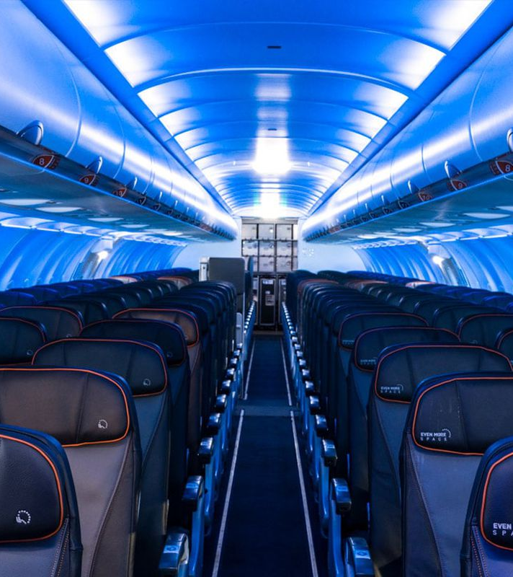
Predicting Airport Delays
ADS505
Team 4:
Hanmaro Song
Eva Chow
Jose Luis Estrada

Slide 2
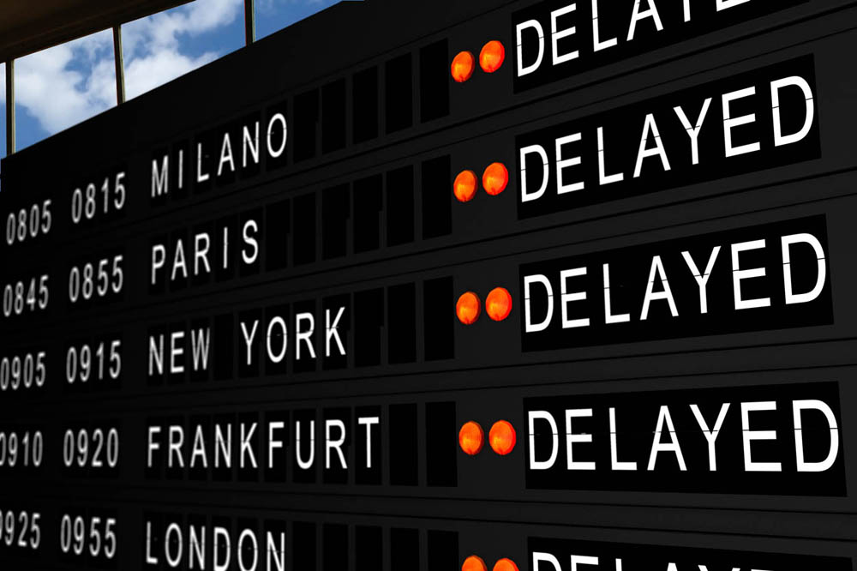
Summary
Three major airports of New York have been experiencing flight delays, which impacts profitability negatively. As a result, business partners search for alternatives to mitigate the financial impact and create a strategy to increase profitability.
The scope of this analysis takes into account all flights from 2013 from all major airlines operating in the New York airports.

Slide 3
Insights
The study captured a total of 32K flights between 16 airlines
Similar distribution between JFK, La Guardia, and Newark airports
No particular month is busier than the other, but the months of June, July, and December show the most significant delays
As expected, travel around major holidays exhibit larger delay times
Their busiest times are in the mornings (6am - 12pm) and evenings (6pm - 12am)
United Airlines, EVA Airways, and JetBlue indicate the highest number of delays (>2K/year)
Among the three airports, Newark had the longest departure delays, followed by JFK, then La Guardia
Notes:
After looking at the data provided, what did we see? Well, our data analysis showed us that 16 airlines serviced the three airports for a total of 32,000 flights out of New York City, with a relatively even distribution of airlines and flights across the three. Looking at the flight data across the entire year of data provided, the months of June, July, and December show the most significant increase in delays, which aligns with the major holidays and peak travel period. Within the day, the airports seem the busiest and exhibit the longest delays in the mornings from 6AM to noon, and evenings from 6PM to midnight. There were also noted delays amongst specific airlines, such as United Airlines, Eva Airwars, and JetBlue. Amongst the three airports, Newark International Airport exhibited the longest delays, followed by JFK, then La Guardia

Slide 4
Model(s) Implementation & Evaluation
Model Name | Accuracy
Bagging Classifier (Decision Tree) | 0.783537
Gradient Boosting Classifier | 0.763787
Random Forest Classifier | 0.746999
Linear Discriminant Analysis | 0.680690
Logistic Regression | 0.656385
Support Vector Machine Classifier | 0.515503
Notes:
Total of 6 models have been built and evaluated.
Among these 6, Bagging classifier with a base model of Decision tree outperforms the other models with 78% accuracy score.
This doesn’t have to be a final model to be used in live but there are still room for improvement. By configuring the model more, it’s possible to have higher accuracy than 78%.

Slide 5
Business Insights & Recommendations
Bagging Classifier with a base model of Decision Tree
Possible improvement with more features such as geo-location (in addition to origin)
Depending on business type, set different threshold for long_delay (30min, 1hr)
Possible to predict more granular (short, medium, long delay)
Set up a business to attract potential customer target(s)
Airports & Airlines can utilize models to optimize in/out flights traffic

Slide 6
Thank you
Hanmaro Song (hanmarosong@sandiego.edu)
Eva Chow (echow@sandiego.edu)
Jose Luis Estrada (joseestrada@sandiego.edu)

